Slide 1
AI Specialist Capstone project
Notes:
Download the latest version of this compendium here: https://w3.ibm.com/services/lighthouse/documents/120180

Slide 2


Introduction
This capstone is your opportunity to move beyond theory and apply AI in a real development workflow.
You will leverage Agentic IDEs (IBM BOB/ AWS Kiro) to transform designs into working frontend solutions - just like in modern AI-powered engineering teams.
By the end, you won’t just understand AI-assisted development - you’ll be able to demonstrate it. Remember to focus not just on the outcome, but on how you leverage AI to think, build, and solve problems differently.
By completing this capstone, you will be able to:
✅ Leverage Agentic IDEs to accelerate frontend development
✅ Convert UI designs into working code
✅ Generate, review, and refine AI-produced components
✅ Set up, test, and validate end-to-end frontend applications
✅ Use Git workflows to manage and deliver code
✅ Clearly articulate your AI-assisted development process

Slide 3
Before You Start
Get access to IBM BOB (fill in this form) or use another Agentic IDE such as AWS Kiro
Install the IDE on your local setup (Bob installation guidelines)
Join the Slack channel #applied-ai-specialist-capstone-project for support

Slide 4

How to Complete this Capstone
Go through the Use Case from slide 5 - 13
Work on the tasks on slides 14 and 15
Record a 3-minute video describing the steps you took, focusing on how you used Agentic IDE to help in the process
Submit the video and attach GitHub link for Review (next item in Learning Plan)
Now that you know what is required to complete this capstone, let’s get started!

Slide 5
Use Case
Your client would like to take their bookstore online.
Use IBM BOB or another Agentic IDE e.g. AWS Kiro to create an online store where a customer can browse, select and purchase books. The following are the customer journeys:
E-store Home |  |  |  | Catalogue |  |  |  | Payment & Purchase confirmation
1 |  | Login Page |  | 5 |  | Select the Category of products |  | 9 |  | Select the address for delivery
2 |  | User Authentication User Browses Order History with Buy In Again feature Recommends items based on Order History |  | 6 |  | Browse the brands |  | 10 |  | Initiate payment with the right option Redeem gift points
3 |  | Access Product catalogue for each category |  | 7 |  | Select the product (product tagged with tentative delivery date) Related products appear for selection |  | 11 |  | Payment confirmation
 |  |  |  | 8 |  | Add the product(s) to basket |  | 12 |  | Confirmation on purchase Cancel Order Within 48 hrs

Slide 6
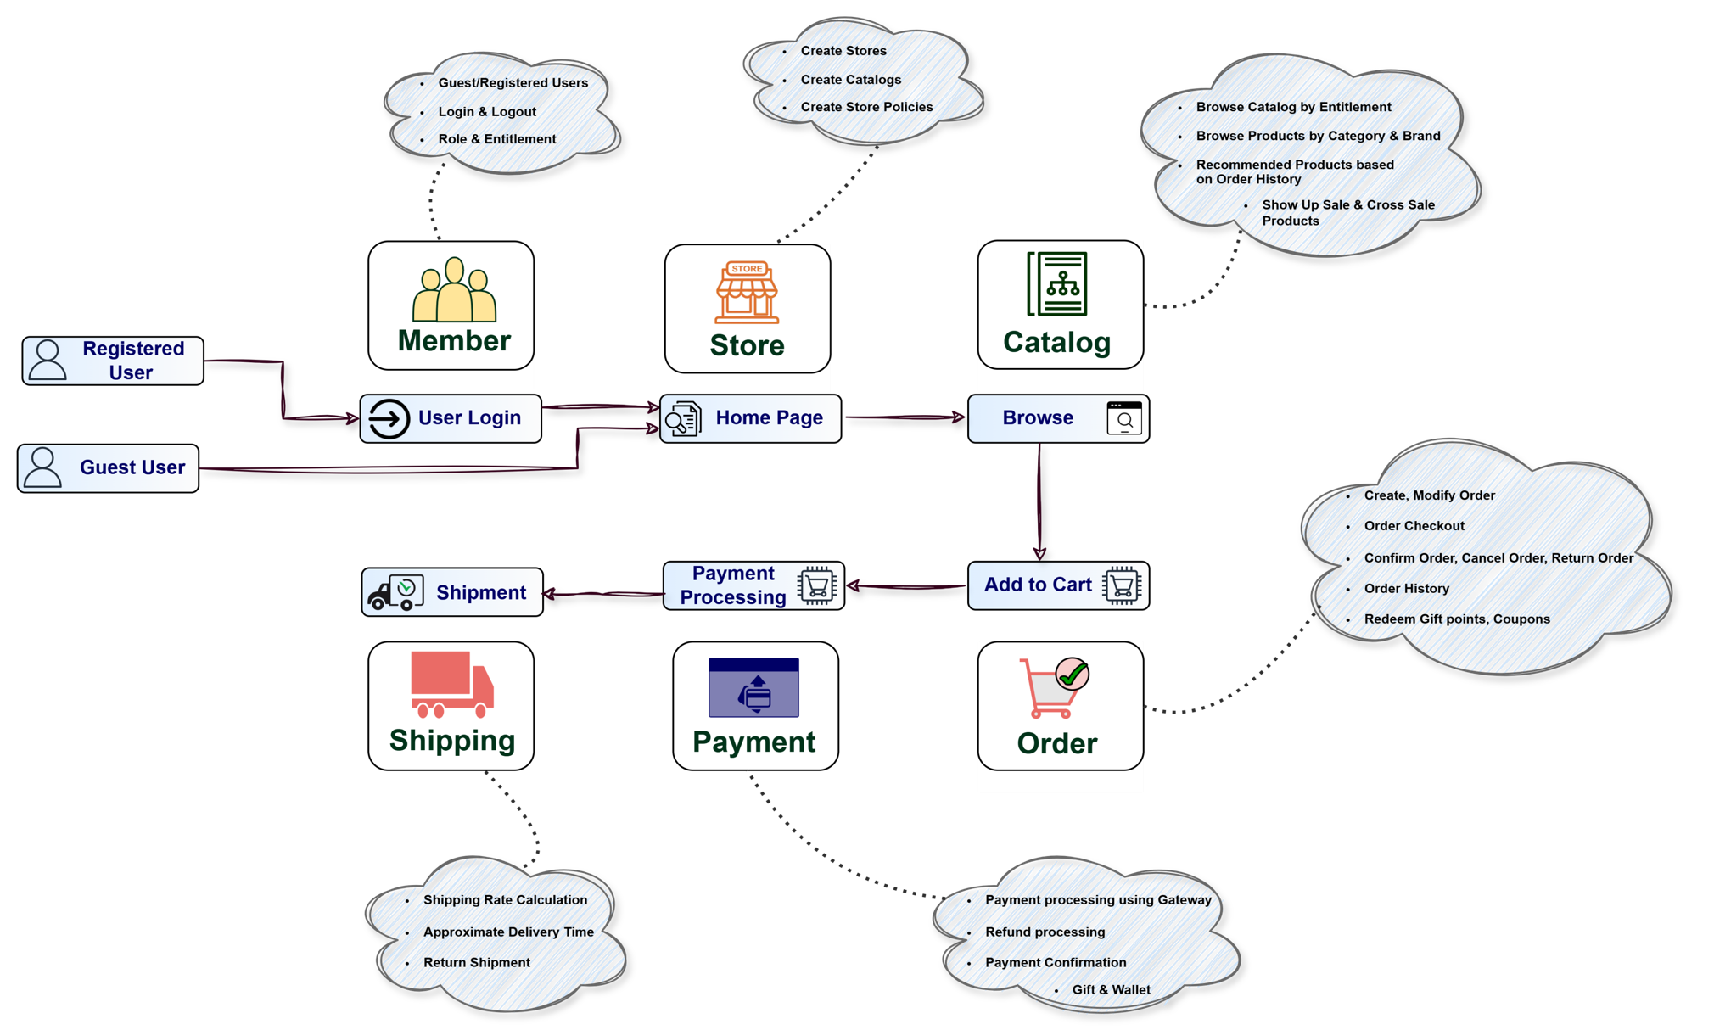
Architecture of the Online Store

Slide 7
Objectives
As a part of the AI Specialist training curriculum you are expected to complete the following:
Get an access to IBM BOB (fill in this form) (you can also use another Agentic IDE such as AWS Kiro)
Install the IDE on your local setup (Bob installation guidelines)
Go through the use case from Slide 3 to Slide 11
Work on the tasks on slide 12
Record a video describing the steps you took and focus how you used Agentic IDE to help in the process
Join the slack channel #applied-ai-specialist-capstone-project for any SME help
Original slide, hidden to maintain source
**Any software installed for development can be removed post the development**

Slide 8
Use Case: An E-commerce platform to view, browse and purchase books
Original slide, hidden to maintain source
The following are the customer journeys:
E-store Home |  |  |  | Catalogue |  |  |  | Payment & Purchase confirmation
1 |  | Login Page |  | 5 |  | Select the Category of products |  | 9 |  | Select the address for delivery
2 |  | User Authentication User Browses Order History with Buy In Again feature Recommends items based on Order History |  | 6 |  | Browse the brands |  | 10 |  | Initiate payment with the right option Redeem gift points
3 |  | Access Product catalogue for each category |  | 7 |  | Select the product (product tagged with tentative delivery date) Related products appear for selection |  | 11 |  | Payment confirmation
 |  |  |  | 8 |  | Add the product(s) to basket |  | 12 |  | Confirmation on purchase Cancel Order Within 48 hrs
Description of use case: Create an online store where a customer can browse, select and buy the selected products.

Slide 9

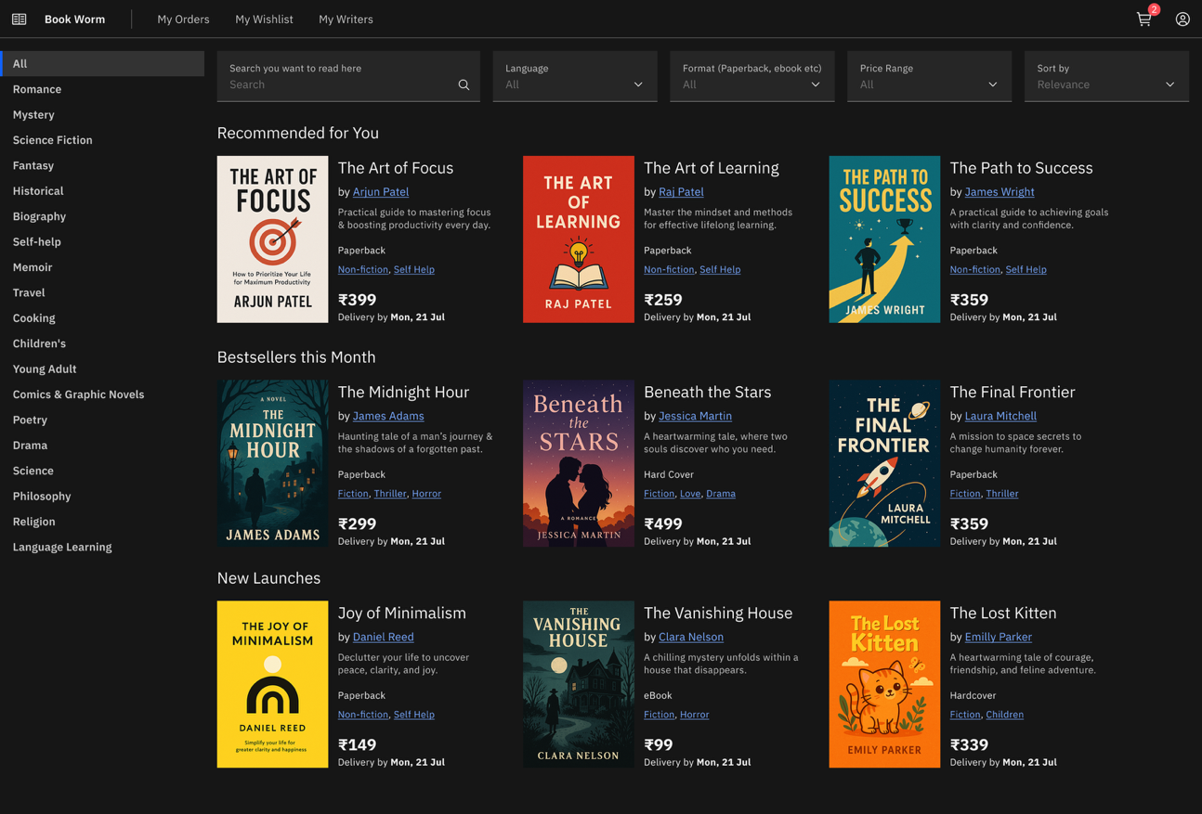
E-Bookstore Platform to be built with Agentic IDE
Characteristics of the e-bookstore platform
Landing page with the availability of books
Selection of books
Buy the books and commit a payment
**The next slides will depict the build of the platform**

Slide 10


The Catalogue Page
Features
Select the Category of products
Access Product catalogue for each category
Browse the brands
Select the product
Related products appear for selection
User Browses Order History with Buy In Again feature
Footer

Slide 11

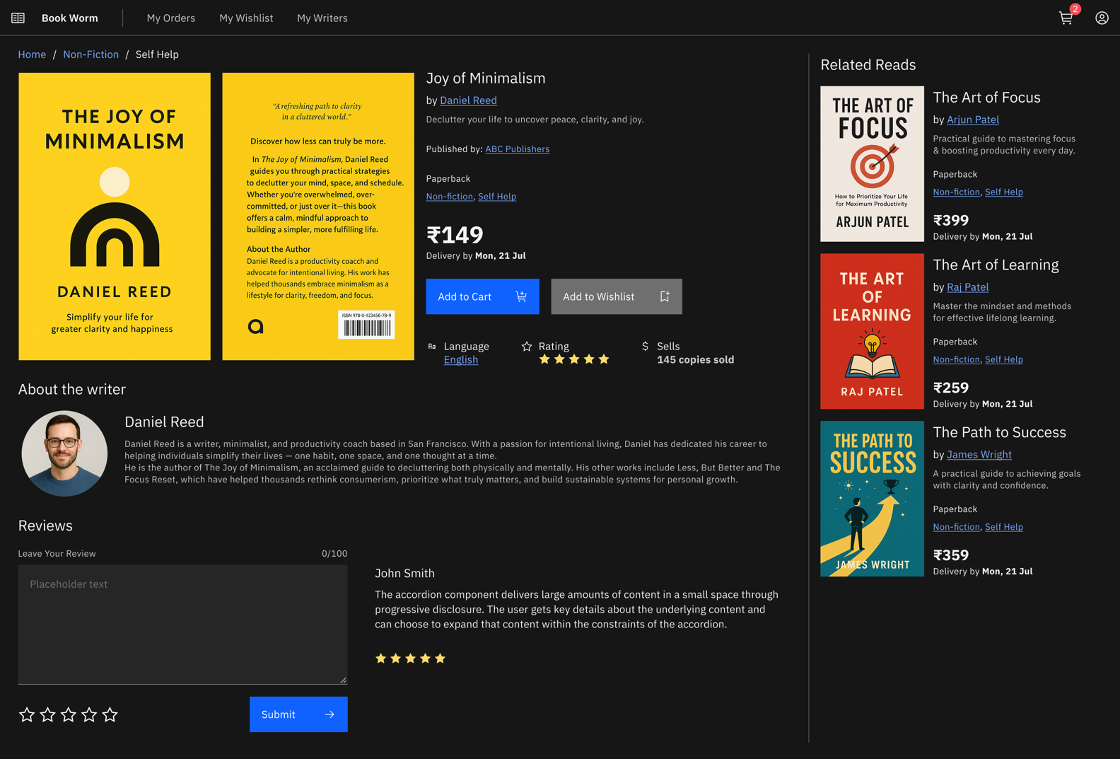
Shopping Cart
Features
Add the product(s) to basket
Recommends items based on Order History
Footer

Slide 12
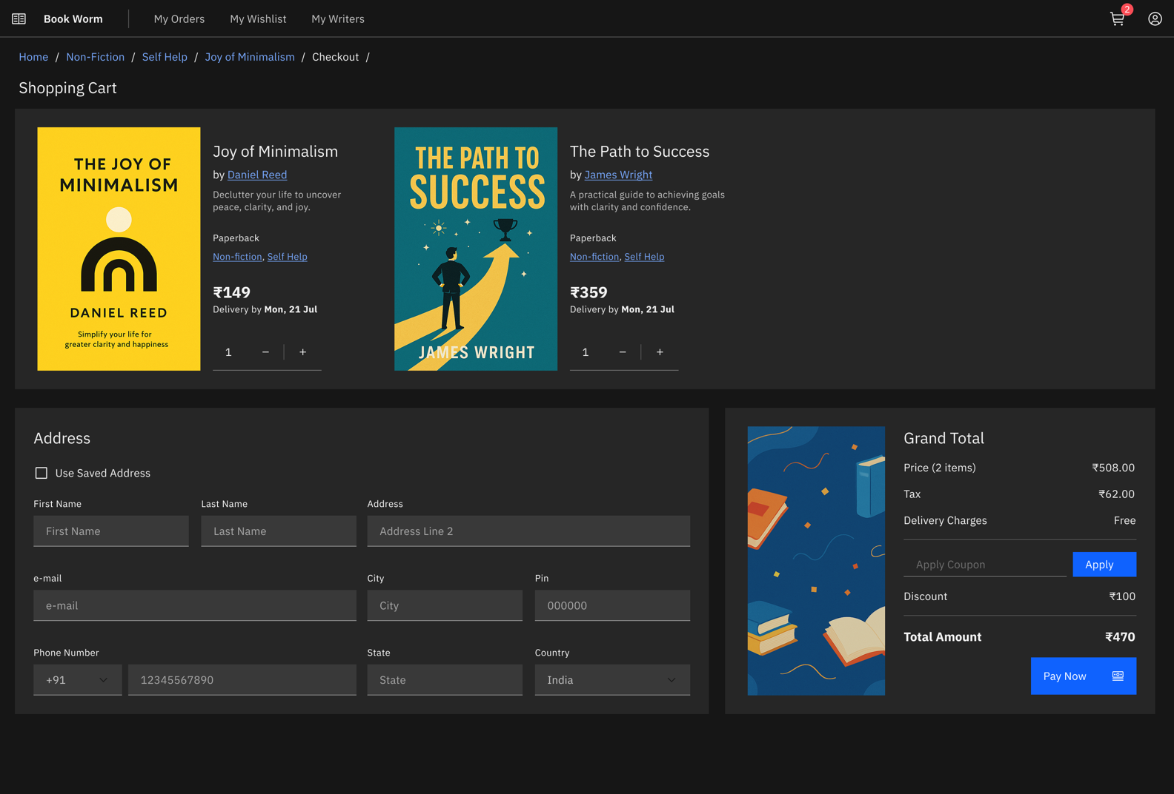
Payment & Purchase
Features
Select the address for delivery
Initiate payment with the right option
Redeem gift points
Footer

Slide 13
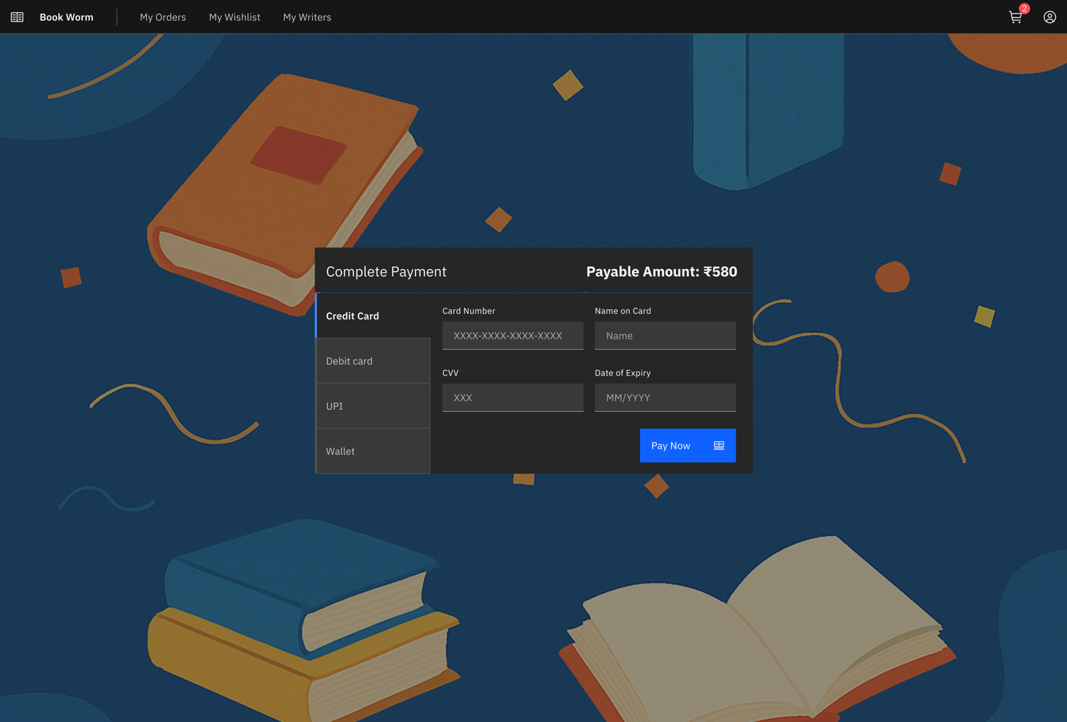
Payment Screen
Features
Initiate payment with the right option
Complete the payment
Footer

Slide 14
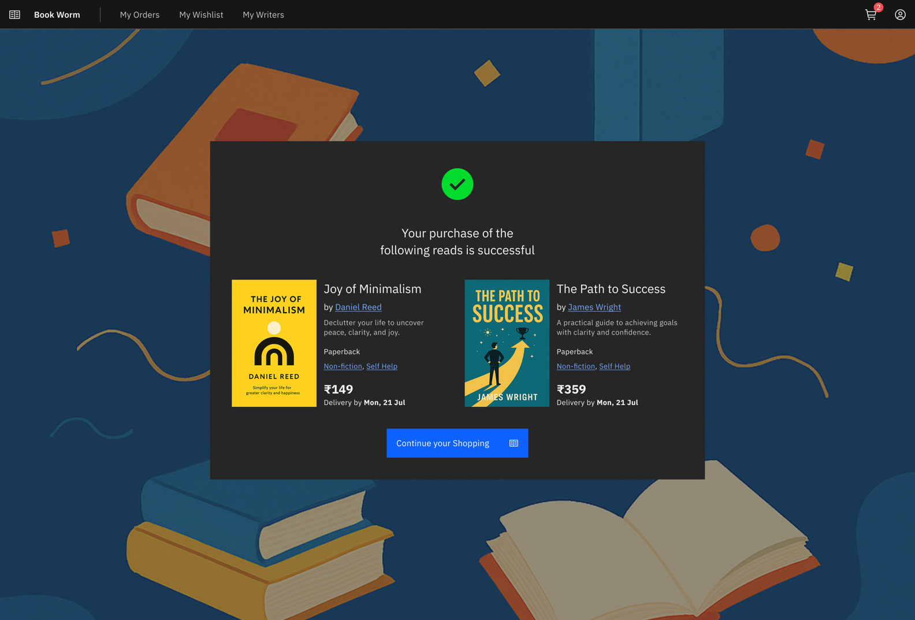
Payment & Purchase
Features
Confirmation on purchase
The message should bring up the purchase completion
Footer

Slide 15
Technology Components and Workflow
Database: PostgreSQL
AI augmentation on UI: Vibe coding with IBM BOB (or AWS KIRO)
Prepare the data model design based on wireframes (Manual)
Open API spec generation
AI augmented backend services: IBM BOB (or AWS KIRO)
AI augmented test case generator: ICA Agent (Choose an agent Ex: Test Scenario Generator,
API Testcase generator, Test case generator for React etc.)
Readiness and deployment on a local machine and if you have a cloud environment access (e.g AWS ROSA or IBM ROKS) you can deploy there
PR on your personal GitHub with access provided to your Manager
Record a video describing the steps you took and submit it for your Manager for review

Slide 16

Front-End Development Workflow with IBM BOB/ AWS Kiro
Step 8: Improve and Refine
Fix UI inconsistencies
Improve spacing/alignment
Add loading states and validations
Optimize reusable components
Clean up CSS/Tailwind classes
Step 9: Git Check-in
Create feature branch
Stage files
Commit changes
Push branch
Create Pull Request for review.
Steps 1 - 4
Step 1: Prepare UI Reference Images
Capture or export the UI designs/screens as .png or .jpg
Step 2: Open IBM BOB/KIRO
Launch IBM BOB or KIRO
Step 3: Provide Screenshots to AI
Upload the UI screenshots/images into IBM BOB/KIRO
Use clean full-screen images whenever possible
Organize screens clearly (Homepage, Cart, Checkout, Payment, etc.)
Start a new front-end development session/project
Select the target framework if prompted: e.g. React
Provide a clear prompt such as:
Generate responsive React frontend code from these bookstore UI screenshots using reusable components and modern styling.
“Use Tailwind CSS”
“Create reusable card and navbar components”
“Make the layout responsive”
Step 4: Generate Frontend Code (web or mobile – your choice)
Optional additions –examples:
Ask IBM BOB/KIRO to generate:
page layouts
reusable components
CSS/Tailwind styling
routing structure if needed
“Generate React + Tailwind code from these screens”
“Generate Angular components from these screenshots”
“Create responsive ecommerce UI components”
Example prompts:
If you require any support, reach out to #applied-ai-specialist-capstone-project

Slide 17
Front-End Development Workflow with IBM BOB/ AWS Kiro
Step 8: Improve and Refine
Fix UI inconsistencies
Improve spacing/alignment
Add loading states and validations
Optimize reusable components
Clean up CSS/Tailwind classes
Step 9: Git Check-in
Create feature branch
Stage files
Commit changes
Push branch
Create Pull Request for review.
Steps 5 - 9
Step 5: Review Generated Code
Verify:
Step 6: Setup Local Project
Create local frontend project
Step 7: Run and Test Locally (web or phone simulator)
Start development server
Step 8: Improve and Refine
Fix UI inconsistencies
Clean up CSS/Tailwind classes
component structure
folder organization
responsiveness
reusable components
naming conventions
dark/light theme consistency
Refactor generated code if necessary
Remove duplicate or unnecessary code blocks
Integrate frontend with backend APIs if backend is already available
Install dependencies
Copy generated code into appropriate folders
Test all screens/components
Verify responsiveness on desktop, mobile
Check : buttons, forms, navigation, cart/payment flows
Improve spacing/alignment
Add loading states and validations
Optimize reusable components
Step 9: Git Check-in
Create feature branch
Stage files
Commit changes
Push branch
Create Pull Request for review.
If you require any support, reach out to #applied-ai-specialist-capstone-project

Slide 18


Submission of Capstone
Completed all steps and created your video?
Ensure that the following criteria are met:
Your video is about 3 minutes long
You have described the steps you took to develop responsive front-end solution for an eCommerce bookstore utilizing agentic tools such as IBM Bob.
You have a link to your GitHub repository
Click “Mark Complete” on the Capstone Project tile of Your Learning
Submit your video together with GitHub repository link for Review via the next tile in your Learning Plan.

Slide 19
Front-End Development Workflow with IBM BOB/KIRO
Step 1: Prepare UI Reference Images
Capture or export the UI designs/screens as .png or .jpg
Use clean full-screen images whenever possible
Organize screens clearly (Homepage, Cart, Checkout, Payment, etc.)
Step 2: Open IBM BOB/KIRO
Launch IBM BOB or KIRO
Start a new front-end development session/project
Select the target framework if prompted: e.g. React
Step 3: Provide Screenshots to AI
Upload the UI screenshots/images into IBM BOB/KIRO
Provide a clear prompt such as:
Generate responsive React frontend code from these bookstore UI screenshots using reusable components and modern styling.
  Optional additions: examples
  “Use Tailwind CSS”
  “Create reusable card and navbar components”
  “Make the layout responsive”
Step 4: Generate Frontend Code (web or mobile – your choice)
Ask IBM BOB/KIRO to generate:
page layouts
reusable components
CSS/Tailwind styling
routing structure if needed
Example prompts:
“Generate React + Tailwind code from these screens”
“Generate Angular components from these screenshots”
“Create responsive ecommerce UI components”
Step 5: Review Generated Code
Verify:
  component structure
  folder organization
  responsiveness
  reusable components
  naming conventions
  dark/light theme consistency
Refactor generated code if necessary
Remove duplicate or unnecessary code blocks
Step 6: Setup Local Project
Create local frontend project
Copy generated code into appropriate folders
Install dependencies
Integrate frontend with backend APIs if backend is already available
Step 7: Run and Test Locally (web or phone simulator)
Start development server
Test all screens/components
Verify responsiveness on desktop, mobile
Check : buttons, forms, navigation, cart/payment flows
Step 8: Improve and Refine
Fix UI inconsistencies
Improve spacing/alignment
Add loading states and validations
Optimize reusable components
Clean up CSS/Tailwind classes
Step 9: Git Check-in
Create feature branch
Stage files
Commit changes
Push branch
Create Pull Request for review.
Original slide, hidden to maintain source
Raise any questions through the slack channel:
#applied-ai-specialist-capstone-project

